Slide 1
Marketing Lecture # 11 Muhammad asad Instructor department of computer science

Slide 2

Key Learning Point :-
- Discussion about the market positioning

Slide 3
Imagine you want to be, let’s say, a detergent manufacturer, and there are thousands of other detergents in the market.
Why do you think customers will buy your detergent from a collection of “million options”?
However, if your detergent has unique features that can give your customers unique benefits --- then --- That is a different story.
People don’t want to buy a product that claims to do “EVERYTHING” --- Instead, people want a better solution that can tackle at least “SOMETHING” --- You just need to show them that your detergent can specifically do “THIS”.

Slide 4
In simple words --- You need to position your product or service uniquely --- In marketing terms, this is called market positioning.

Slide 5
MARKET POSITIONING
Is a marketing strategy that focuses on --- Creating a unique image or perception of a brand, product, or service in the customer’s mind --- A business can create that unique image by any means.
The four Ps of marketing (promotion, product, price, and place) are important factors in market positioning --- The more a business focuses on these 4 Ps --- The will better --- Will be its positioning in the market.

Slide 6
FOR EXAMPLE
Oxford Shoes brand specializes in making formal shoes --- For highly sophisticated or formal events.
A fast-food franchise that makes unique grilled beef burgers. (like Farid town shahi food point famous related Samosa)
A BMW company specializes in manufacturing luxury cars with unparalleled features.
So, what was the basic theme in these examples?
The sellers in these examples are focusing on a specific point --- rather than --- Catering to a general audience.

Slide 7
TECHNIQUES FOR MARKET POSITIONING
Different businesses use different techniques for market positioning --- However, some most common types of positioning in the market.
1: QUALITY OF A PRODUCT OR SERVICE
2: INNOVATION AND UNIQUENESS
3: PRICE OF A PRODUCT OR SERVICE
4: PRODUCT DIFFERENTIATION
5: CUSTOMER SERVICE
6: NICHE SEGREGATION

Slide 8
1: QUALITY OF A PRODUCT OR SERVICE
Among the notable price wars --- Many brands struggle hard to provide quality --- Yes, when you satisfy your customer with supreme quality --- Price becomes a less-concerned issue.
Example
Chipotle Mexican Grill often known simply as Chipotle --- Is an American chain of fast casual restaurants in the United States --- Has quickly gathered huge reputation --- and --- Scaled to the 14th ranked in the list of top 50 fast-food franchises in the USA (ranking from QSR magazine)
This quality-oriented brand has already captured a significant market share and causing trouble for “big brands”.

Slide 9
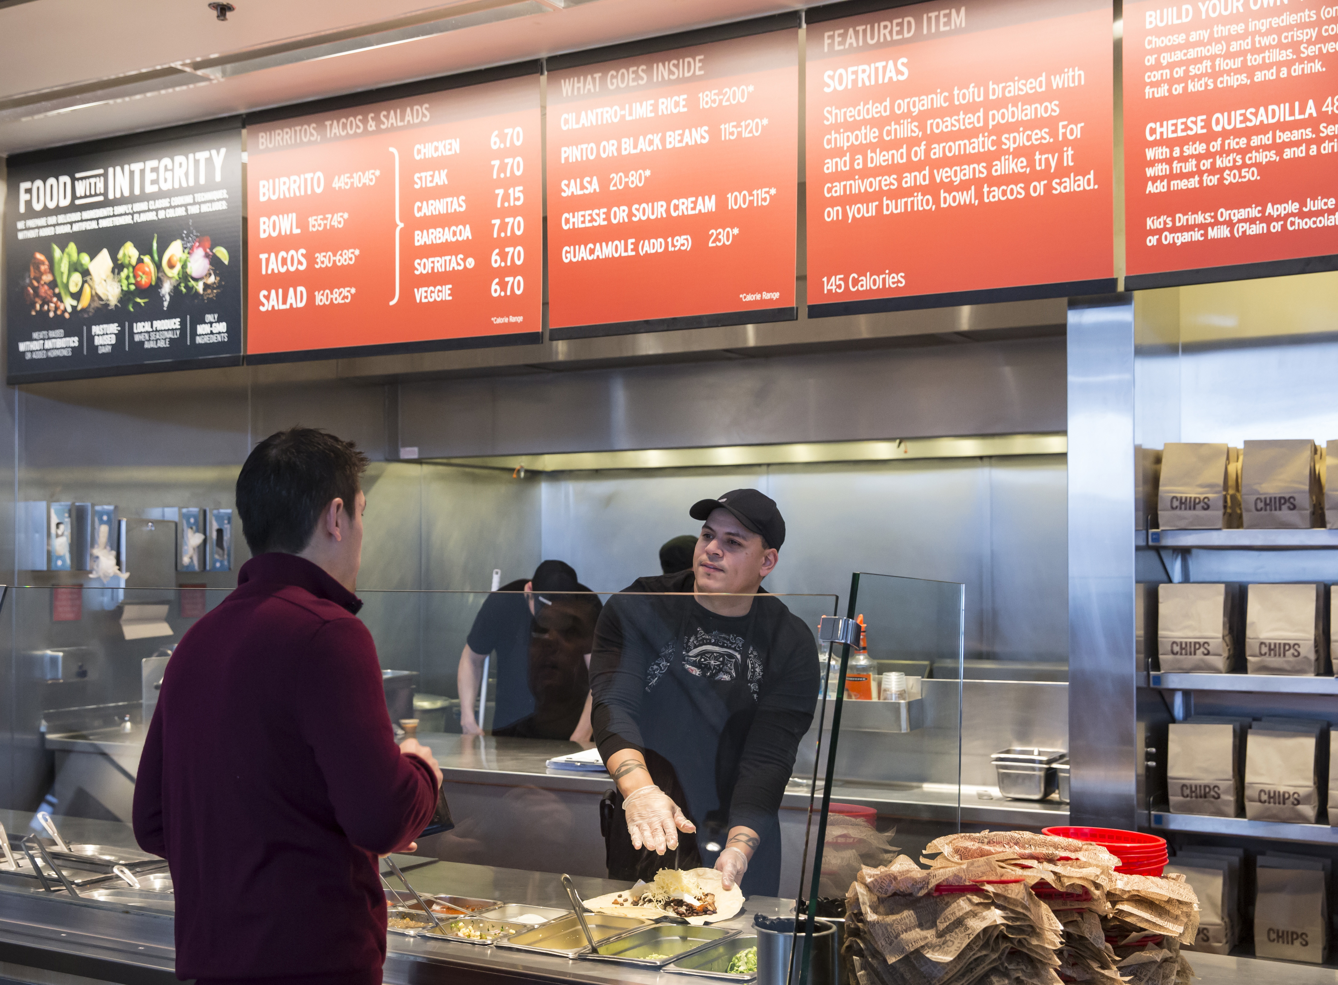
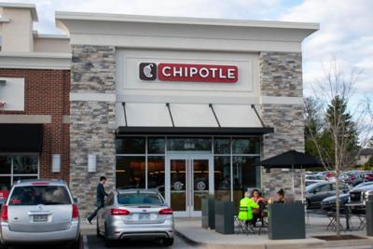
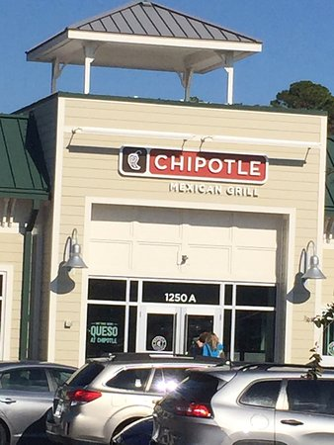

Slide 10
2: INNOVATION AND UNIQUENESS
Many brands focus on providing innovation and uniqueness --- If you can bring something new and attractive --- You can charge higher prices and people will pay for it happily.
Example
What would be a better example of innovation than Apple? --- The electronics industry’s juggernaut has captured a massive global market just --- Because of its mind-blowing and surreal innovations.

Slide 11
3: PRICE OF A PRODUCT OR SERVICE
When a brand is not enriched with innovation or superior quality --- then --- Pricing is an excellent option to challenge your competitors --- Whether --- You accept or not, price is still one of the most critical factors --- that --- Affect many consumer’s purchase decision.
Example
Dollar Shave Club has proved to be a frightening for Gillette --- Because they offer the cheapest razor unit refilling 20 cents --- While Gillette was doing it for $2 to $5 --- Due to this massive difference, Gillette has seen a decreasing market share.

Slide 12
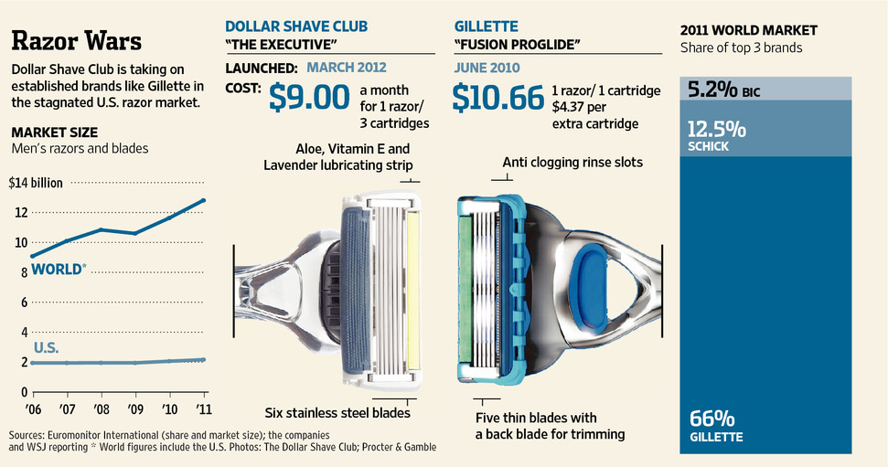

Slide 13
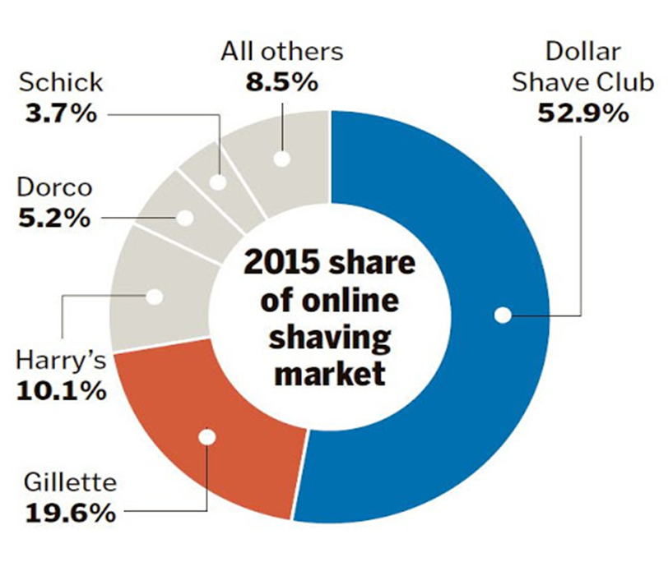

Slide 14
4: PRODUCT DIFFERENTIATION
Similar to innovation --- Product differentiation is another excellent marketing strategy to take the lead --- A different product or service can easily kill the competition.
Example
Tesla has revolutionized the automobile industry with its electronic cars --- This has sidelined many economic cars such as Toyota Prius.

Slide 15
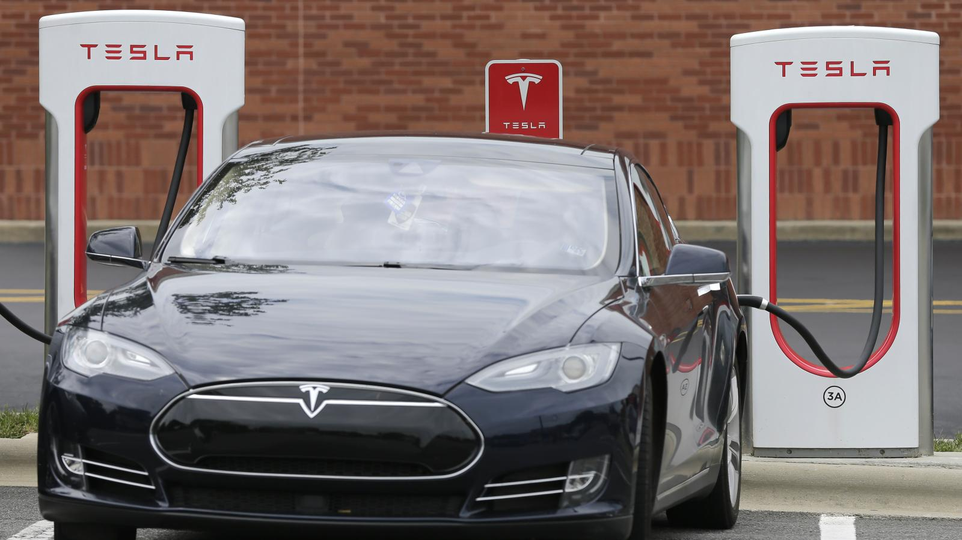

Slide 16
5: CUSTOMER SERVICE
Customer services --- If appropriately managed, can create a massive and defining image in consumer’s minds --- In fact, this category is fundamental in specific industries such as banking and restaurants.
Example
Zappos, an American online shoe company --- Has unique customer service practices --- They respond to every single email they get --- Even if the email is directly for the company’s CEO.

Slide 17
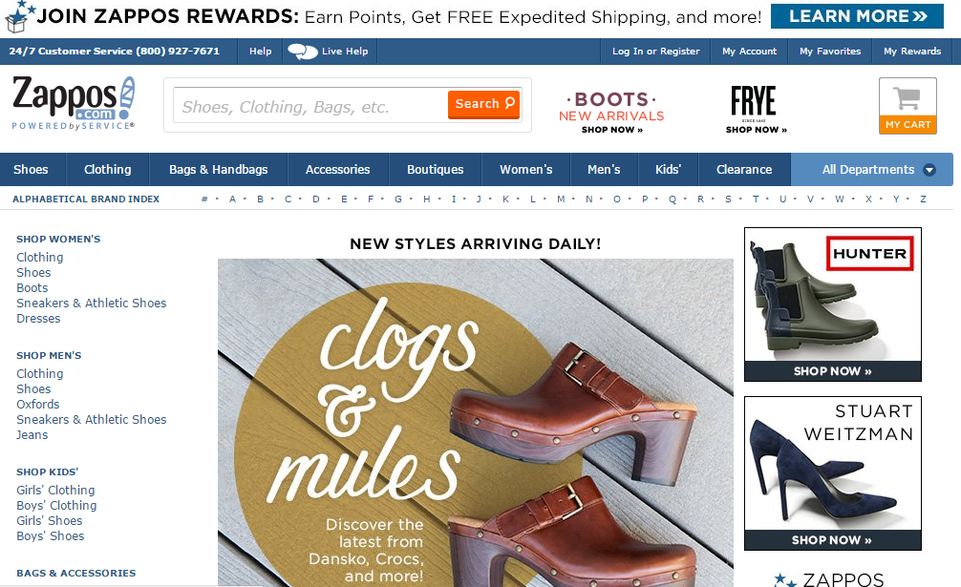

Slide 18
6: NICHE SEGREGATION
A niche market is a segment of a larger market --- That can be defined by its own unique needs, preferences, or identity --- That makes it different from the market at large.
Targeting a micro-level market segment is another super-effective way of market positioning.
Example
Within the market for men’s shoes are many different segments or niches --- Sports shoes for men would be a niche market --- As would shoes for male school students or shoes for professional men and etc.

Slide 19
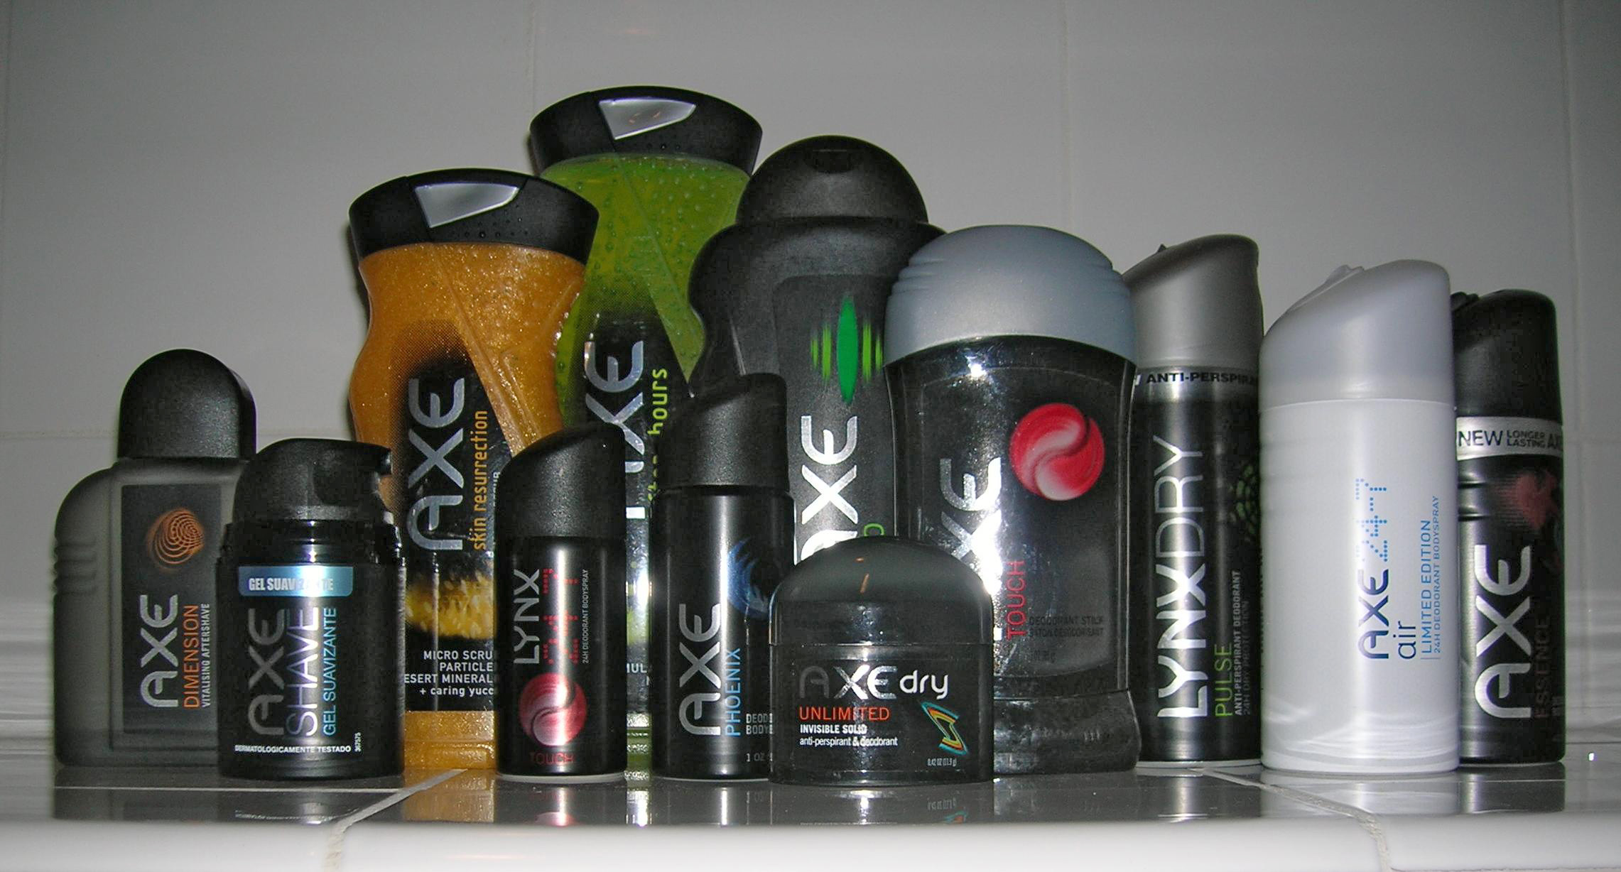
Example
Axe, also known as Lynx --- Is a famous British brand that focuses on male grooming products --- Such as body sprays, deodorants, and etc. for young males.

Slide 20

ANY QUESTION
You can contact me at: asadali@uosahiwal.edu.pk
Your query will be answered within one working day.

